Slide 1
Open Government
Vlora Ademi, Business Development Manager-Edu, a-vademi@microsoft.com
Microsoft Macedonia &Kosovo

Slide 2




Open Government/Open Data
Open Government is based on the principles of:
Open Data is the idea that public data should be broadly accessible and usable by humans and machines, free of any technological, legal or usability barriers.
Transparency
Participation
Collaboration
Enable greater accountability, efficiency and economic opportunity by making government data more open.
through the direct involvement of citizens, developers and entrepreneurs to deliver better and more cost effective government based services.
Generate new ideas for problem solving by fostering cooperation across levels of government and departments, and with the public
Open data typically does not contain personal or identifiable information about private citizens that is not otherwise available through existing Government services

Slide 3
Why is it relevant for Europe
EU directive
  Member States shall ensure that, where the re-use of documents held by public sector bodies is allowed, these documents shall be re-usable for commercial or non-commercial purposes.
  Our central estimate for the value of PSI is €27 billion annually. http://ec.europa.eu/information_society/policy/psi/docs/pdfs/pira_study/commercial_final_report.pdf
  Public sector information (PSI) is the single largest source of information in Europe. It is produced and collected by public bodies and includes digital maps, meteorological, legal, traffic, financial, economic and other data. Most of this raw data could be re-used or integrated into new products and services, which we use on a daily basis, such as car navigation systems, weather forecasts, financial and insurance services
EU Digital agenda par.2.7.4
  ….eGovernment services offer a cost-effective route to better service for every citizen and business and participatory open and transparent government. eGovernment services can reduce costs and save time for public administrations, citizens and businesses. They can also help mitigate the risks of climate change, natural and man-made hazards by including the sharing of environmental data and environment-related information.

Slide 4
Barriers for reuse...
Opened data are published to application specific, non-reusable formats
Lack of terminology and data consistency
Cost of provisioning and delivery. Data is most often stored on servers within Public authorities, not prepared to allow external, scalable access
Open data frameworks NOT publicly available for developers (all developing languages) with tools, sample code, documentation to support easy reuse of the data
NOT possible to publish Open data to enable
        cost efficiency and reuse features enablement
        Nondiscriminatory availability for developers and ISV’s
Notes:
Data is held in application specific, non-reusable formats (sometimes technical formats, but more often proprietary government semantics) as web portals
Lack of terminology of data consistency (onetime publications vs. ongoing update, live stream vs. snapshot, “lifecycle” of data )
Cost of provisioning and delivery. Data is most often stored on servers within Public authorities, not prepared to allow external, scalable access. Lack of low cost efficient platforms to initiate the network effects of combining different data sources in innovation solutions and services.
Software development frameworks for developers to facilitate the development of innovative applications. These should be technology and business model neutral – inclusive open. Contains i.e. sample code, documentation how to access data and the “meaning” of data.
Open and publically available frameworks should exist to enable interested governments to expose and publish data as timely as possible (real-time?)

Slide 5

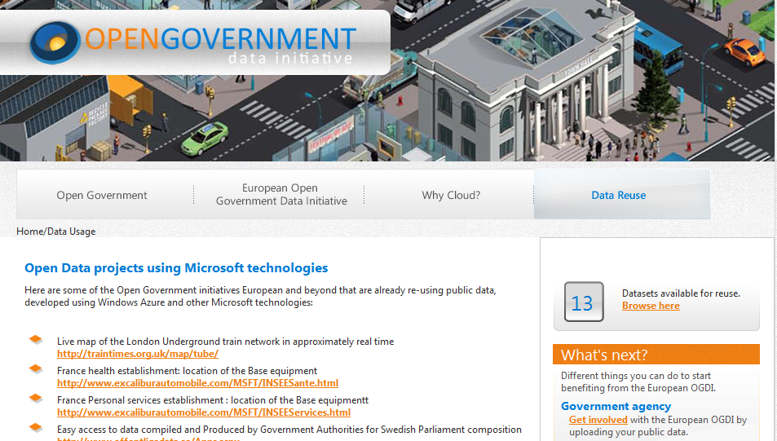
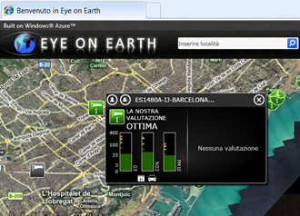

Open Data enablement - Cloud
The cloud
ISV’s and third parties can access the data and include them in their applications to offer innovative service to Citizens
Data are uploaded on a self service basis
Data are stored in Windows Azure
Data are uploaded on a self service basis
Data are stored in Windows Azure
Data are uploaded on a self service basis
Government Agencies now must deliver content to citizens
Public Sectors ISV’s, Universities research centers
Notes:
Now governments must
Deliver useful content to citizens
Continue to cut costs
Maintain privacy and security
Free the data, make it useful
Governments are under pressure to deliver better, more comprehensive information services to citizens while simultaneously cutting costs and strengthening security. Pervasive incompatibility between data housed in different systems creates a major barrier to the kind of interoperability that enables governments to attain these IT goals.
Providing the tools to improve a rapidly changing world is the critical challenge for governments and enterprises. Responsible governments strive to provide those tools efficiently, as well as meet the sometimes conflicting obligation to be transparent and protect their citizens. Providing responsible access to information—to provide Open Data—can help with those goals.
To accomplish this, governments must be able to consolidate citizen’s data from multiple systems, represent data from heterogeneous systems in simple and accessible ways, and combine systems and data to create new services. Using emerging protocols, smart tagging, semantics, and document format standards, it is possible to expose data from incompatible systems for broad access.
Microsoft has made open access to data part of its interoperability strategy, enabling governments to unlock data from heterogeneous repositories and make it available in a flexible spectrum of e-government services. With Open Data, users of Microsoft systems can access data — as well as important context and data description information — from non-Microsoft systems. Similarly, systems running on other platforms can now access data housed in Microsoft systems in a streamlined and meaningful way. We are committed to improving data access interoperability but with security and privacy intact.
This WE platform is a strategic asset for all the WE countries to engage with central and local Government agencies on specific opportunities to open up their identified sets of data, bringing them on our Azure platform before our Competitor.
Government transparency: public data are opened up to be available for local ISV’s, developers communities (PHP, C#) , Government agencies ISV partners for integration in their own applications to provide additional and innovative services to Citizens
Efficiency: public government data are stored and managed in agencies datacenters and no IT procedure exists to transfer and make them available to third parties in an efficient and sustainable way. Open data will allow this by storing those data in the cloud and by offering standard and repeatable procedures to transfer data.To develop and boost local economy : the availability of new data sets will provide opportunities to local ISV to integrate their existing applications or to create new applications that can offer new and innovative services to Citizens leveraging the sets of data that have been opened up.

Slide 6
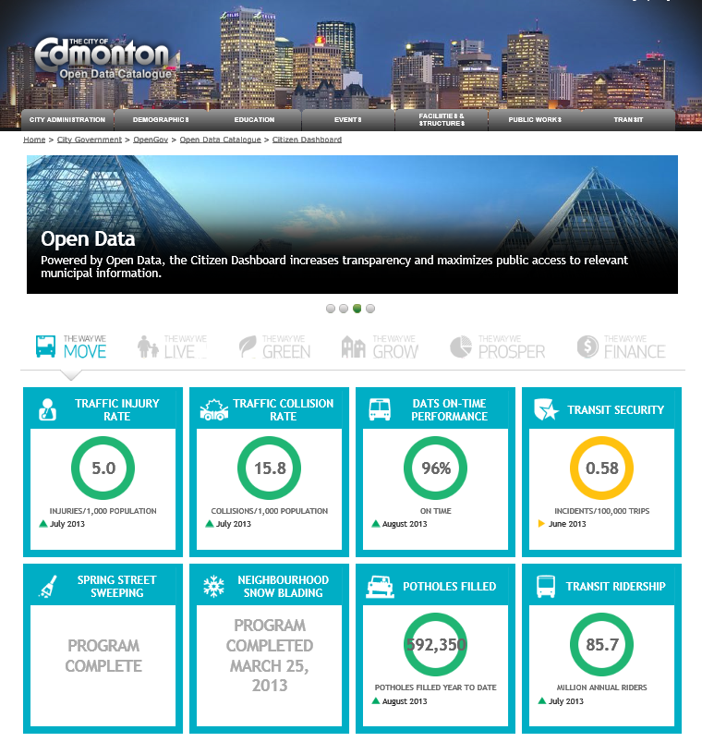
City of Edmonton - https://data.edmonton.ca/dashboard/move

Slide 7
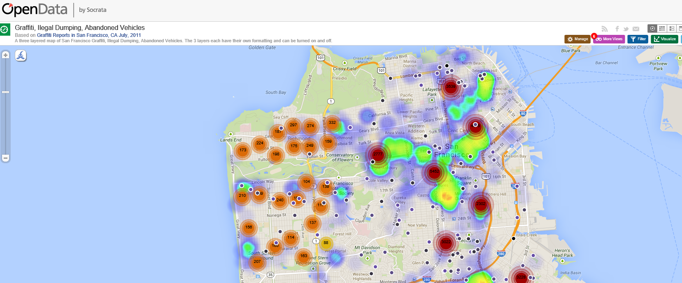
San Francisco https://opendata.socrata.com/dataset/Graffiti-Ilegal-Dumping-Abandoned-Vehicles/abcv-fija

Slide 8
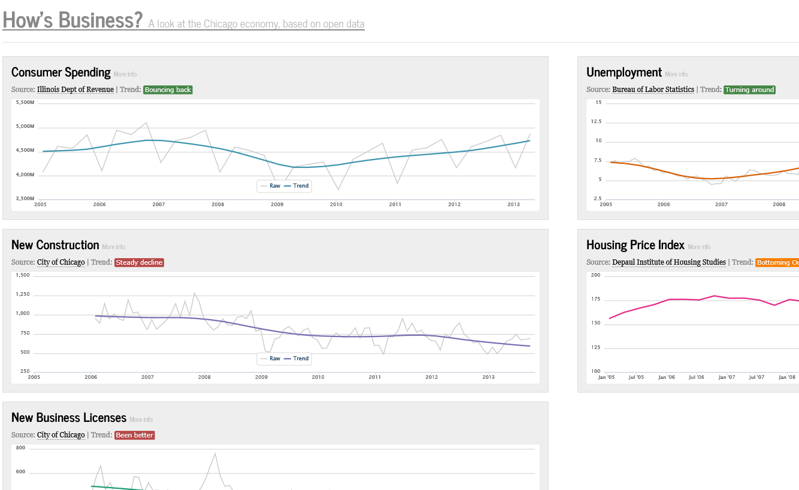
Chicago, how’s business http://howsbusinesschicago.org/

Slide 9



Big Data defined
A new generation of technologies and architectures designed to extract value economically from very large volumes
of a wide variety of data by enabling high-velocity capture, discovery, and/or analysis. — IDC
This definition encompasses hardware and software that integrates, organizes, manages, analyzes, and presents data. The “Big Data” these systems are handling is characterized by:
Data Volume—
Large
Data Variety—Unstructured
Rapid Velocity—Complex
Government Records and other systems driving paper conversion to digital form. More information is being gathered, and greater detail
of existing information is being captured and stored.
Text-based documents, images, audio, and video files; new sources of data and a lack of standard data models.
Fueled by real-time data collection, constantly changing information, and the growth of monitors, sensors, and social networks. The majority of transportation, environmental data generated are from various sources.
For additional information on data characteristics, go to the Microsoft Big Data website.

Slide 10

















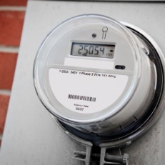
Some Common Big Data Scenarios
IT infrastructure optimization
Legal
discovery
Sentiment analysis
Traffic flow optimization
Web app optimization
Churn
analysis
Natural resource exploration
Weather forecasting
Healthcare outcomes
Fraud
detection
Life sciences research
Advertising targeting
Equipment monitoring
Smart meter monitoring

Slide 11

http://www.bigopendata.eu/

Slide 13
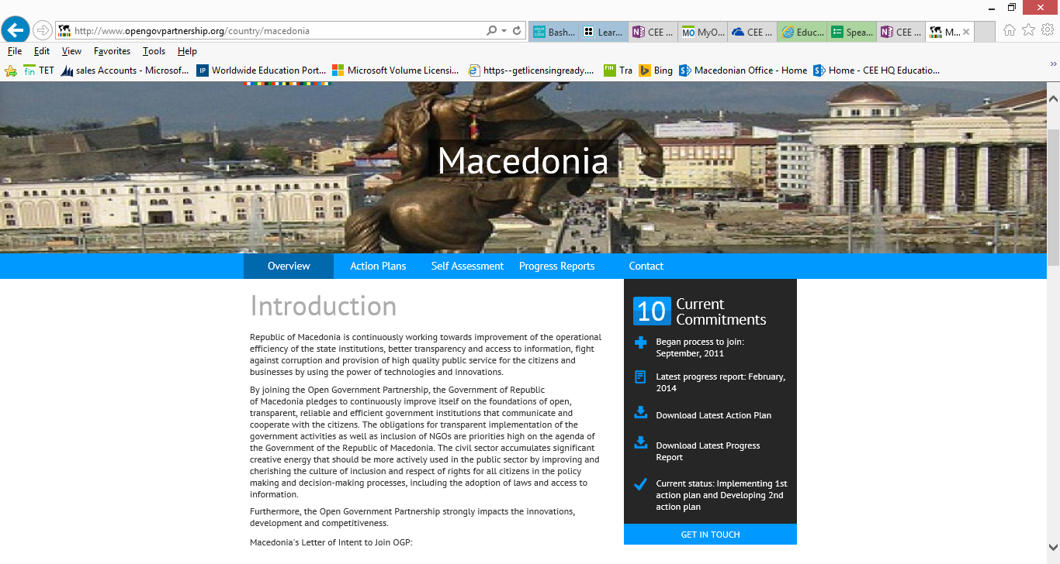
http://www.opengovpartnership.org/country/macedonia

Slide 14
Action To DO Open Government Space
Never lead with any technology
Direct the field to read the action plan docs (less than 15 min read) and familiarize
The docs are very local to the countries
Request a conversation with the Ministry responsible for Open Government (i.e. the Ministry of State Administration)
Discuss the business objectives of the Government here
Request to participate with the Open Data enablement
Engage local partners with the global ones that we have
Work with DPE/DX to generate the critical mass of SMALL but MANY simple open data apps that targets smartphones and tablets

Slide 15
Open Government
Vlora Ademi, Business Development Manager-Edu a-vademi@microsoft.com Microsoft Macedonia &Kosovo

